Slide 1
Object detection in automobiles
Rami Alkafahje & Kai Perich

Slide 2
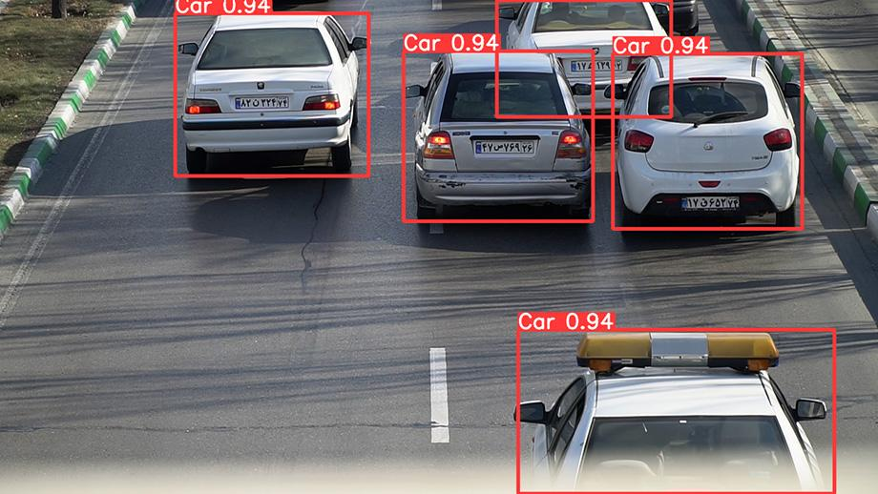
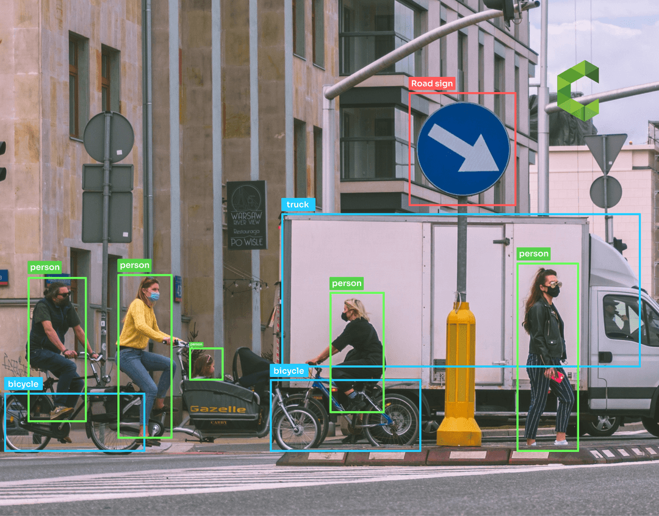
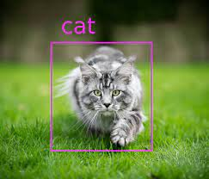
Topic: Object Detection

Slide 3
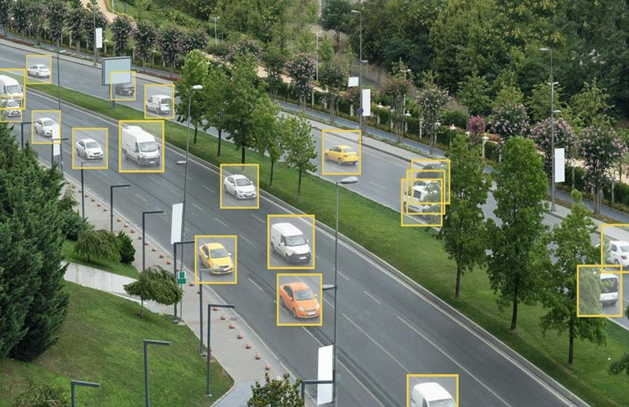
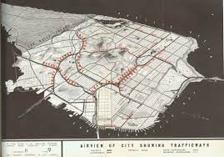
Why car object detection?
Provide information to assist vehicle counting
Identify traffic accidents by detecting cars
Urban traffic planning

Slide 4



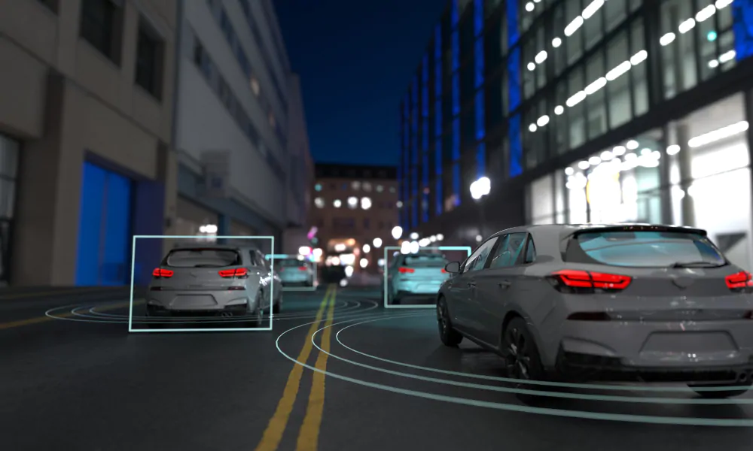




Project Goal
Compare the performance of applying YOLO models
Car Detection

Slide 5
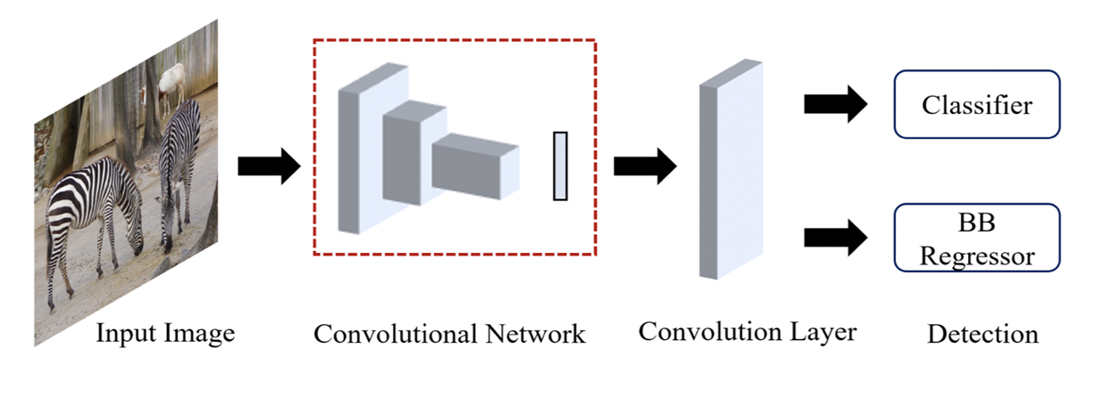
YOLO Model Family

Slide 6
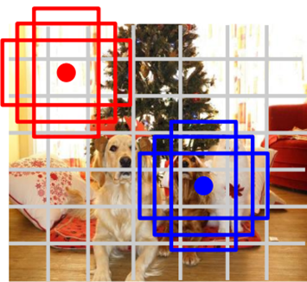
How does YOLO work
Within each grid cell:
Regress from each of the B base boxes to a final box with 5 values:
(dx, dy, dh, dw, confidence)
Predict scores for each of C classes (including background as a class)
Divide Image into M x M grids
Here M = 7
Image a set of base boxes centered at each grid cell
Here B = 3
-Faster but not as accurate as R-CNN
-Poor Detection of small objects

Slide 7


Why do we use the COCO and Kaggle Dataset?
All Yolo models were pretrained on COCO
Collecting over 11000 images for training

Slide 8


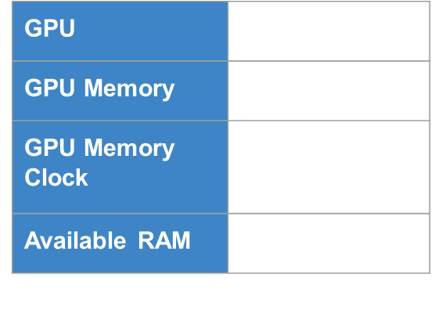

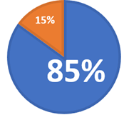
Code implementation: Boundary Boxes & Training
Total Number of Images: 1176
Training set (85%)
Test set (15%)

Slide 9
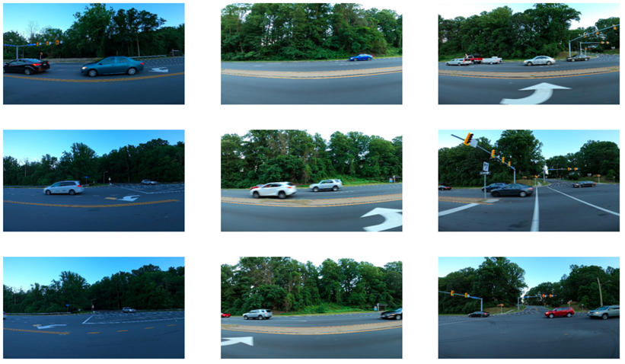
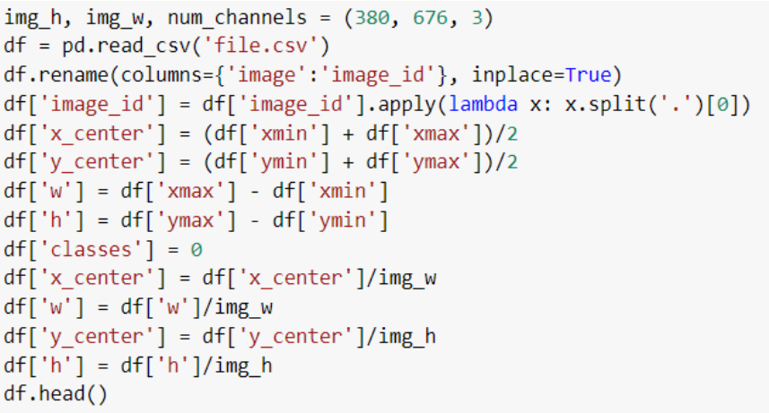
Code implementation: Boundary Boxes & Training

Slide 10
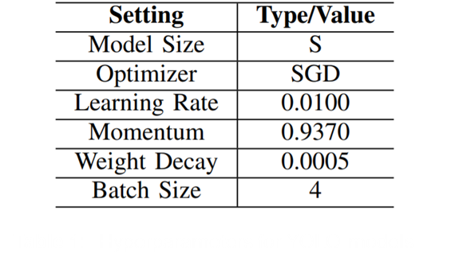
Results & Discussion
Epochs for all models:
30
Notes:
After running all our 3 different models on our trained dataset, we have finally succeeded to get results for all the models.
We used the pretrained weights as the initialization of our models. In order to control parameters, we set the same hyperparameters for YOLOv3, YOLOv4, and YOLOv5, respectively. So this means:
The training epoch was designed as 30, and our batch size was put on 4 for every model
As shown in the table I, the model we used is small (S) due to the limited computational power. Other optional models are medium (M) and large (L), which can be found in the author’s GitHub. But we couldnt use this models since we dont have the computational capacities.

Slide 11
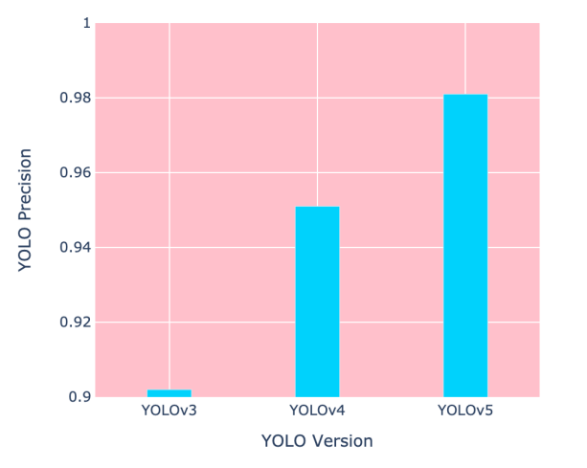
Results & Discussion

Slide 12
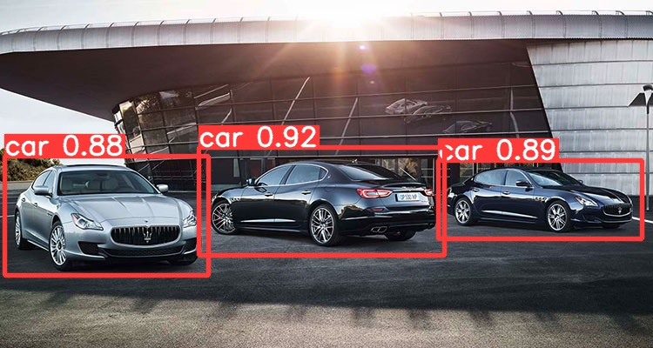
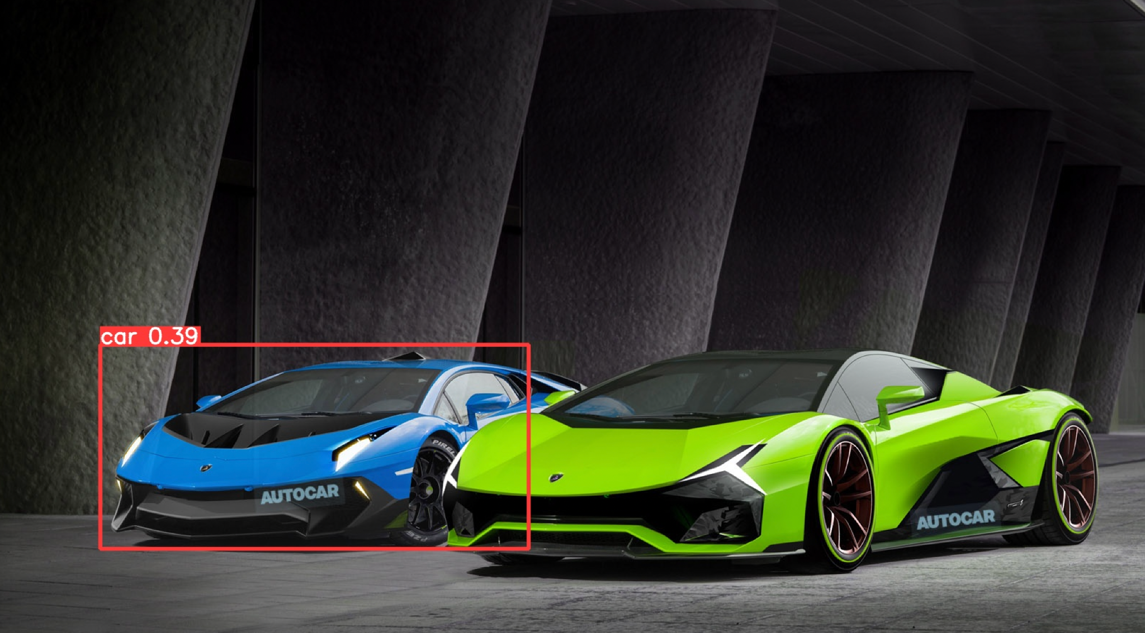
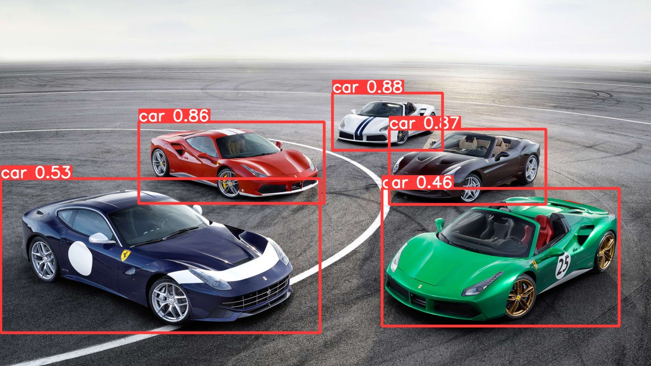
Yolov5: High Confidence in Maserati cars

Slide 13

Conclusion and Outlook

